Slide 1


Tech-Inspire academy
Presented by
Nayan Kothawade
Omkar Kanawade

Slide 2
Introduction:
An online learning platform is a digital tool that provides learners with access to educational resources, instruction, and support over the internet. This platform can be used by students of all ages and backgrounds to learn new skills, advance their knowledge, and achieve their educational goals from anywhere in the world.
Online learning platforms typically offer a wide variety of courses and learning resources, including video lectures, interactive quizzes, discussion forums, and assignments. They also often provide learners with personalized feedback, progress tracking, and certification upon completion of a course or program. With the rise of digital technology and the increasing demand for flexible and accessible education, online learning platforms have become an increasingly popular way for people to learn and grow their skills.

Slide 3
Objective:
The online education platform is intended to provide complete solution for students, teachers as well as internal users (Management Staff) through a single gateway using internet or let say Web Application.
It will enable to students to reach on online learning platform to learn interesting subjects and technologies and can enhance their skills and knowledge without visiting the class physically. It will also enable to the academy to monitor their working hours and schedules. Added features of feedback and appraisal system make the product more reliable.

Slide 4
Scope:
In the modern and evolutionary digital age, access to the information is the key to professional success. In the digital age, learning should have to open for all. E-learning is a boon to people who face obstacles in getting a traditional college education. Online learning creates a momentum of flexible academic scenario also this flexibility ensures working professional can learn simultaneously with full time jobs according to their time management. Student can learn at their own space and pace.

Slide 5
Technology:
ReactJS
Spring Boot
MySQL

Slide 6
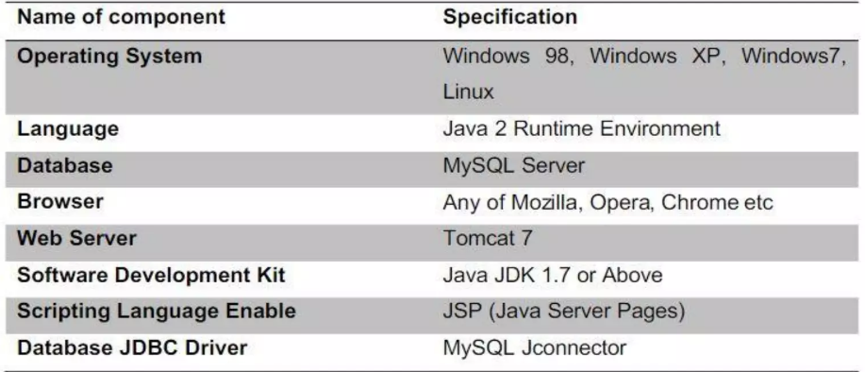
Software Configuration:

Slide 7
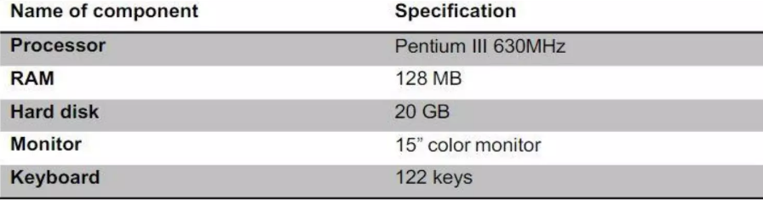
Hardware Configuration:

Slide 8
Functionality:
• Our product as a web based application can provide accessibility and simple user interface.
• It provides complete administration and monitoring over multiple fields of application.
• Users can track their timesheets thoroughly. Also teachers as well as management staffs can handle and update their side.
• The interactive dashboard will provide information of various fields.
• Systems can generate Email and SMS to notify the user.
• System is designed to give the significant monitoring of workflows of progress of students and teachers with their.
• There is an availability of study materials and other important information.
• Administrator and management team can implement changes and features.
• Developers can modify and upgrade the software application . Also can provide safety , security and availability.

Slide 9
The purpose of “Tech-Inspire Academy” app is to enroll student to particular course and assist teachers to manage their schedule. Student can Login on the website and able to Search the course according to it system will show the running batches. It can launch new courses and system will show available time-slot based one teacher’s schedule and selected batch’s schedule. And finally teacher and students can see their respective schedule based on their selected courses. Tech-Inspire Academy contains following core functions: 1) Landing page : It contains portal information with 3 login for admin, teacher, student. 2) Admin Dashboard 3) Teacher Dashboard 4) Student Dashboard Below use case shows the flow of the project and all sub-features of dashboards.

Slide 10
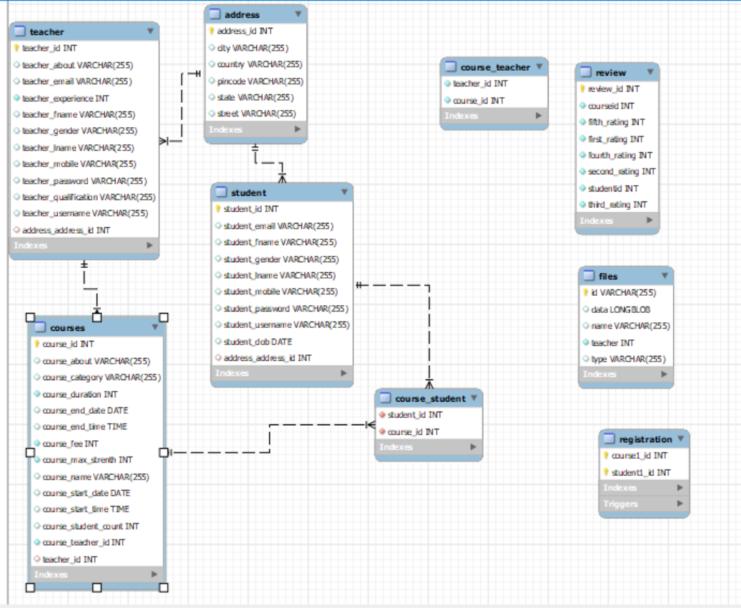
E-R Diagram:

Slide 11
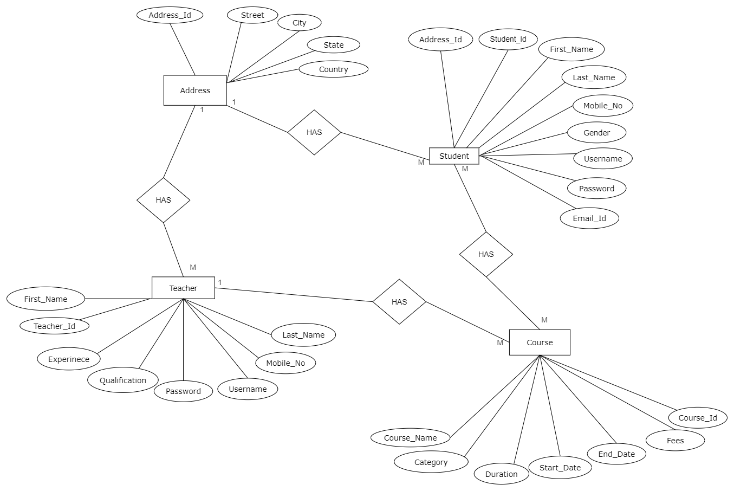
Manually ER Diagram

Slide 12
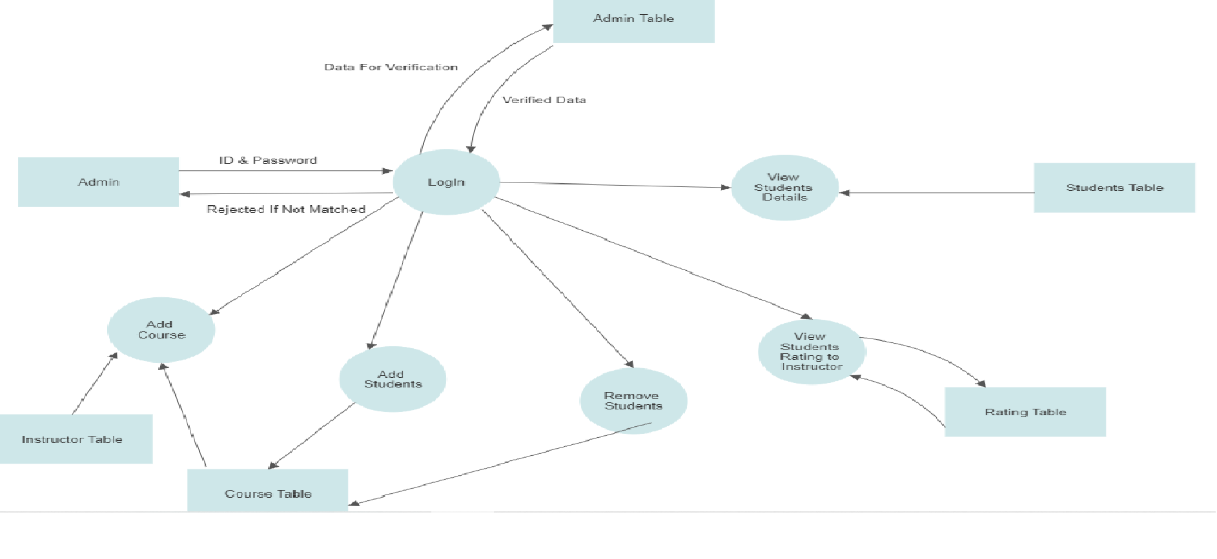
Admin DFD:

Slide 13
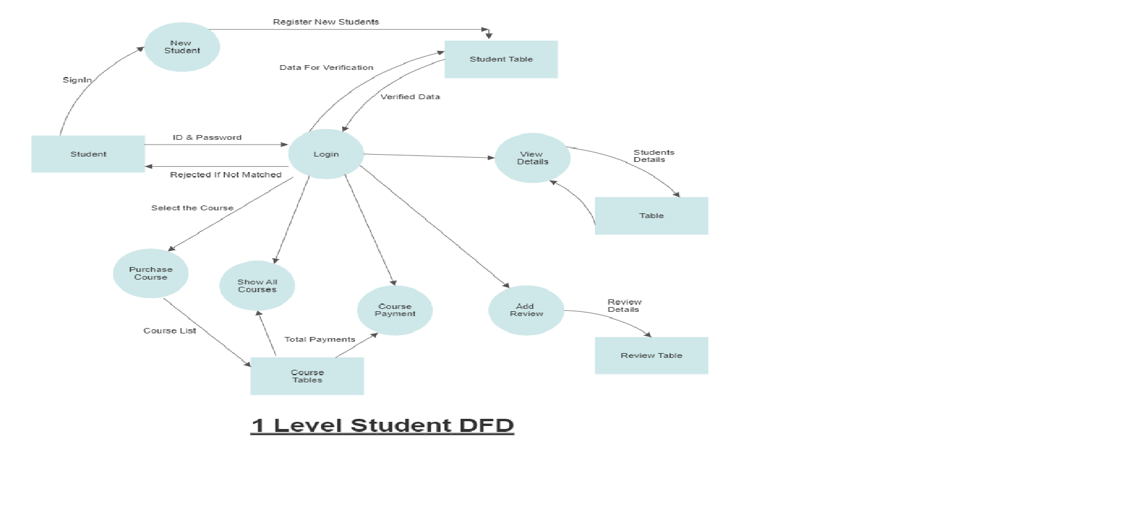
Student DFD:

Slide 14
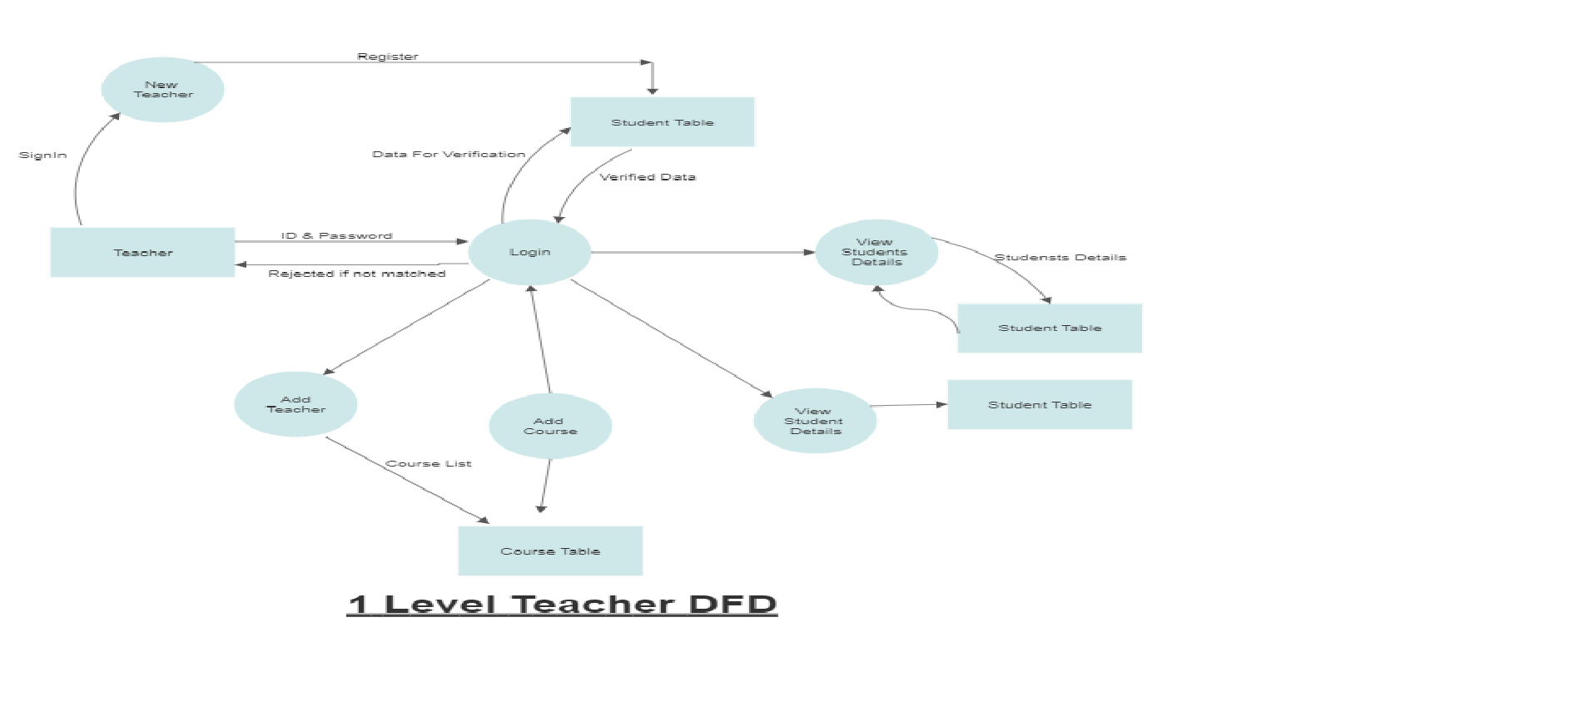
Instructor DFD:

Slide 15
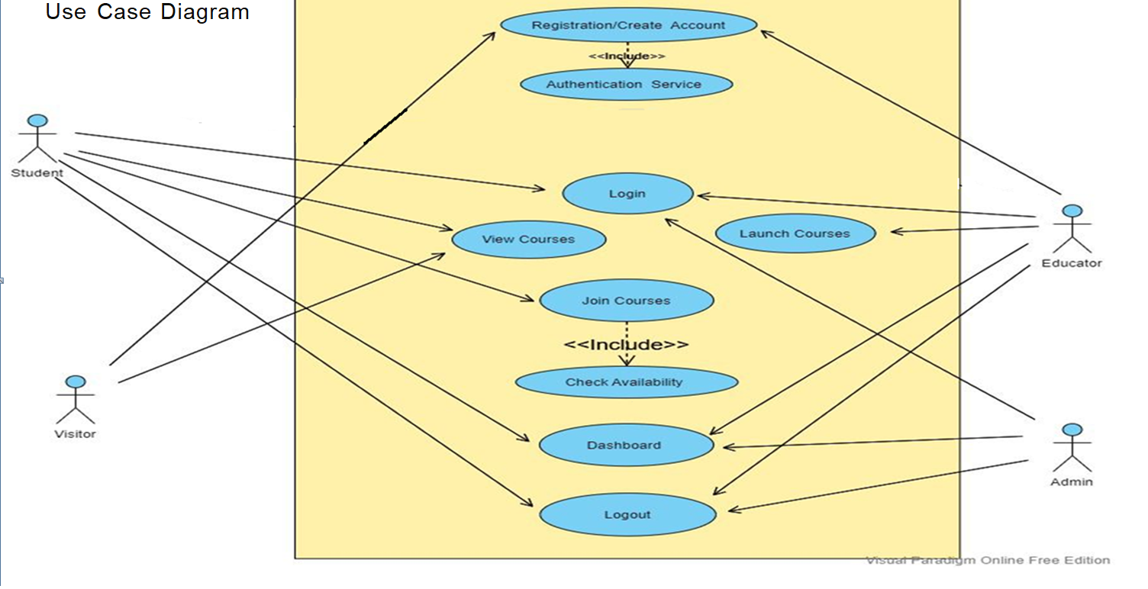
Use Case Diagram

Slide 16
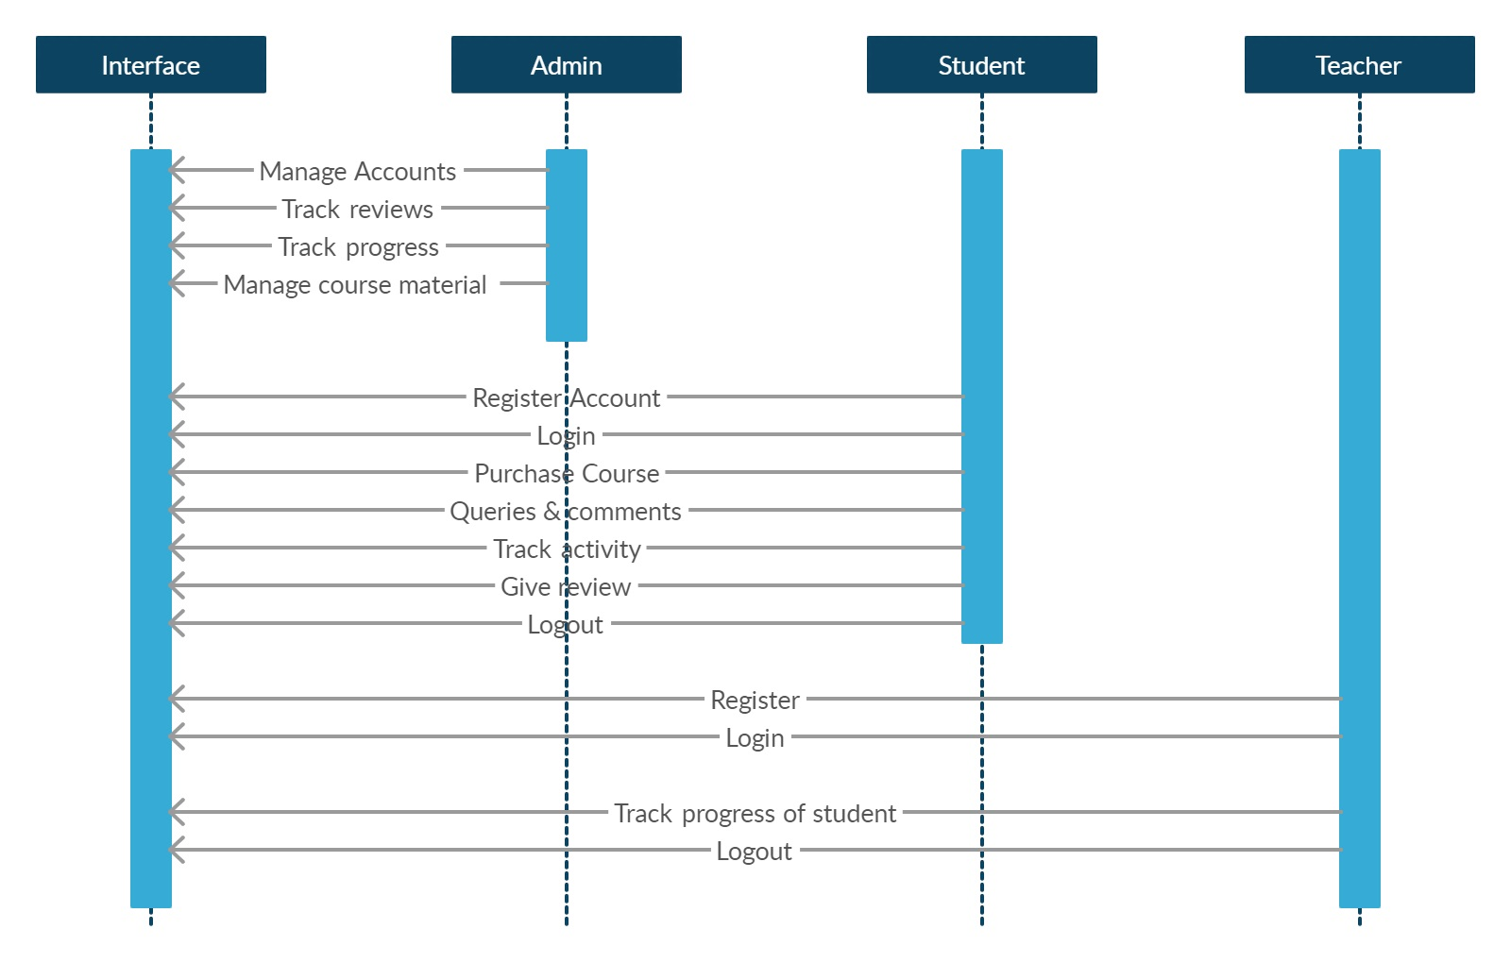
Sequence Diagram:

Slide 17
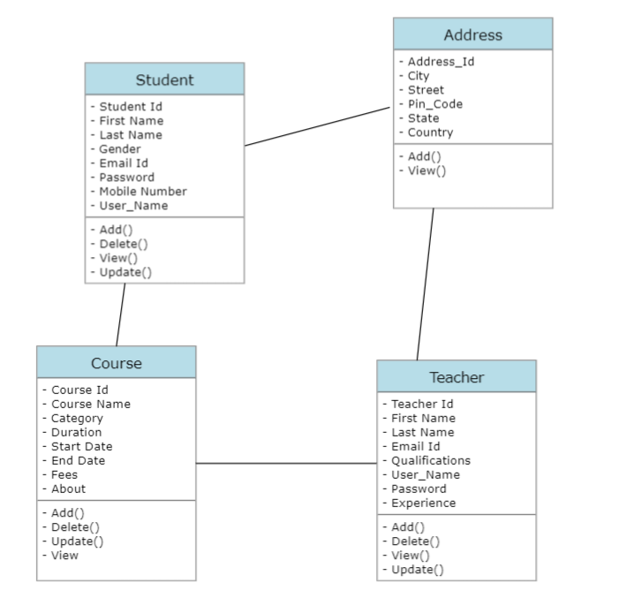
Class Diagram:

Slide 18
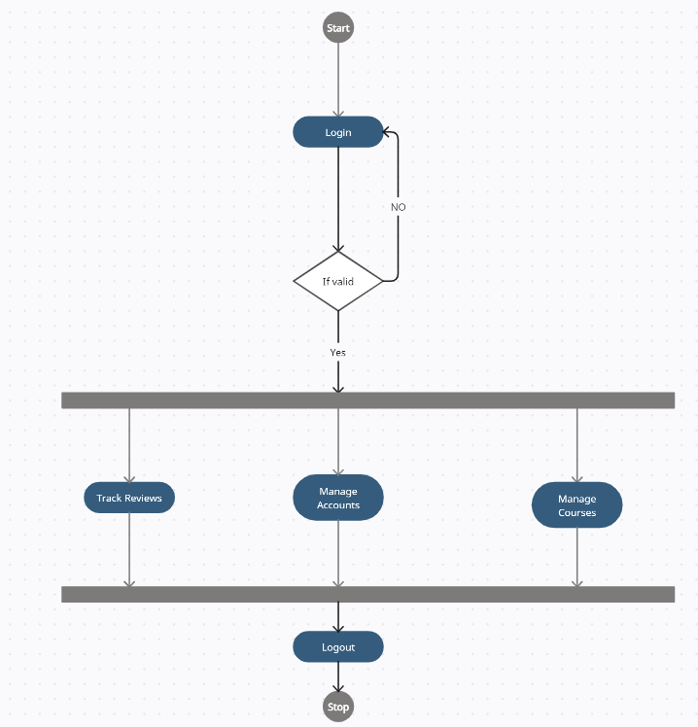
Admin Activity Diagram:

Slide 19
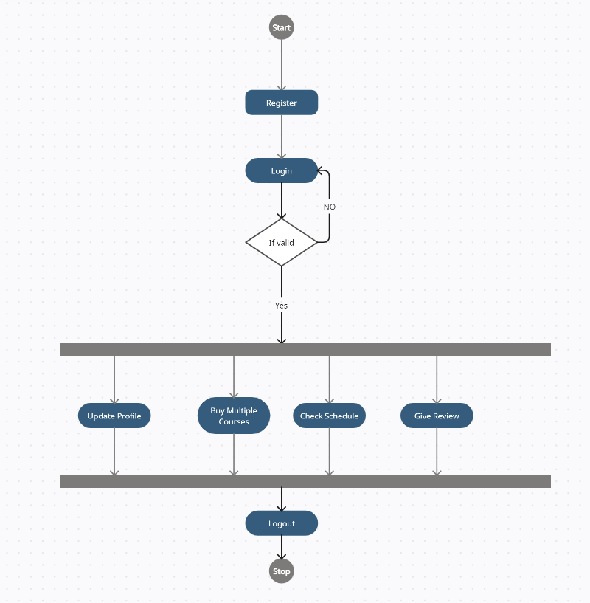
Student Activity Diagram:

Slide 20
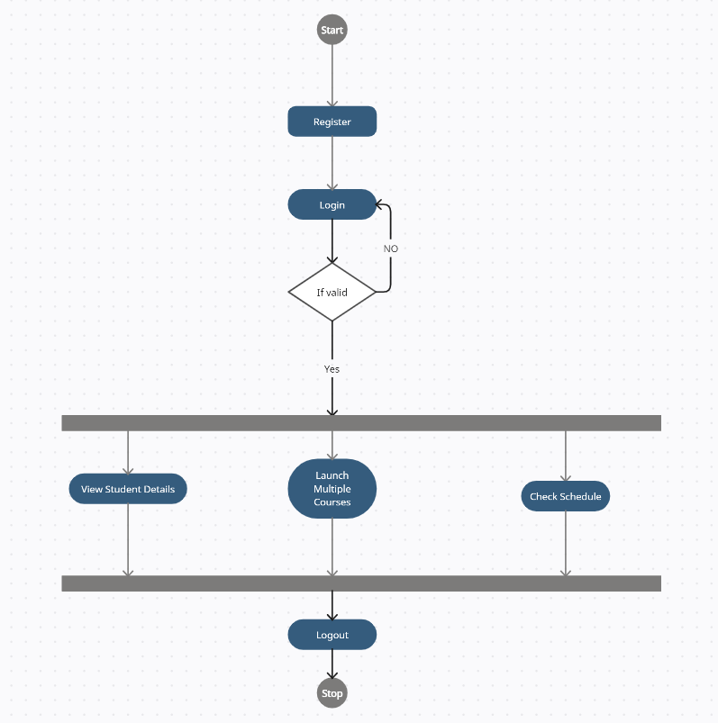
Teacher Activity Diagram:

Slide 21
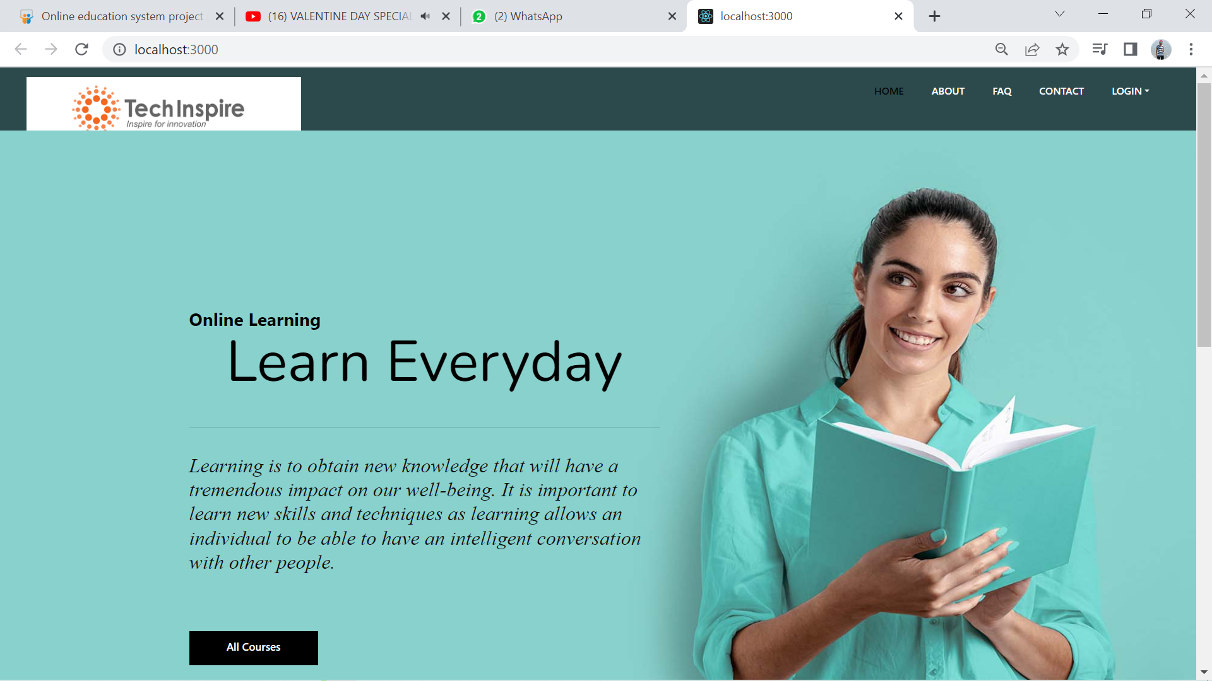
Website Landing Page

Slide 22
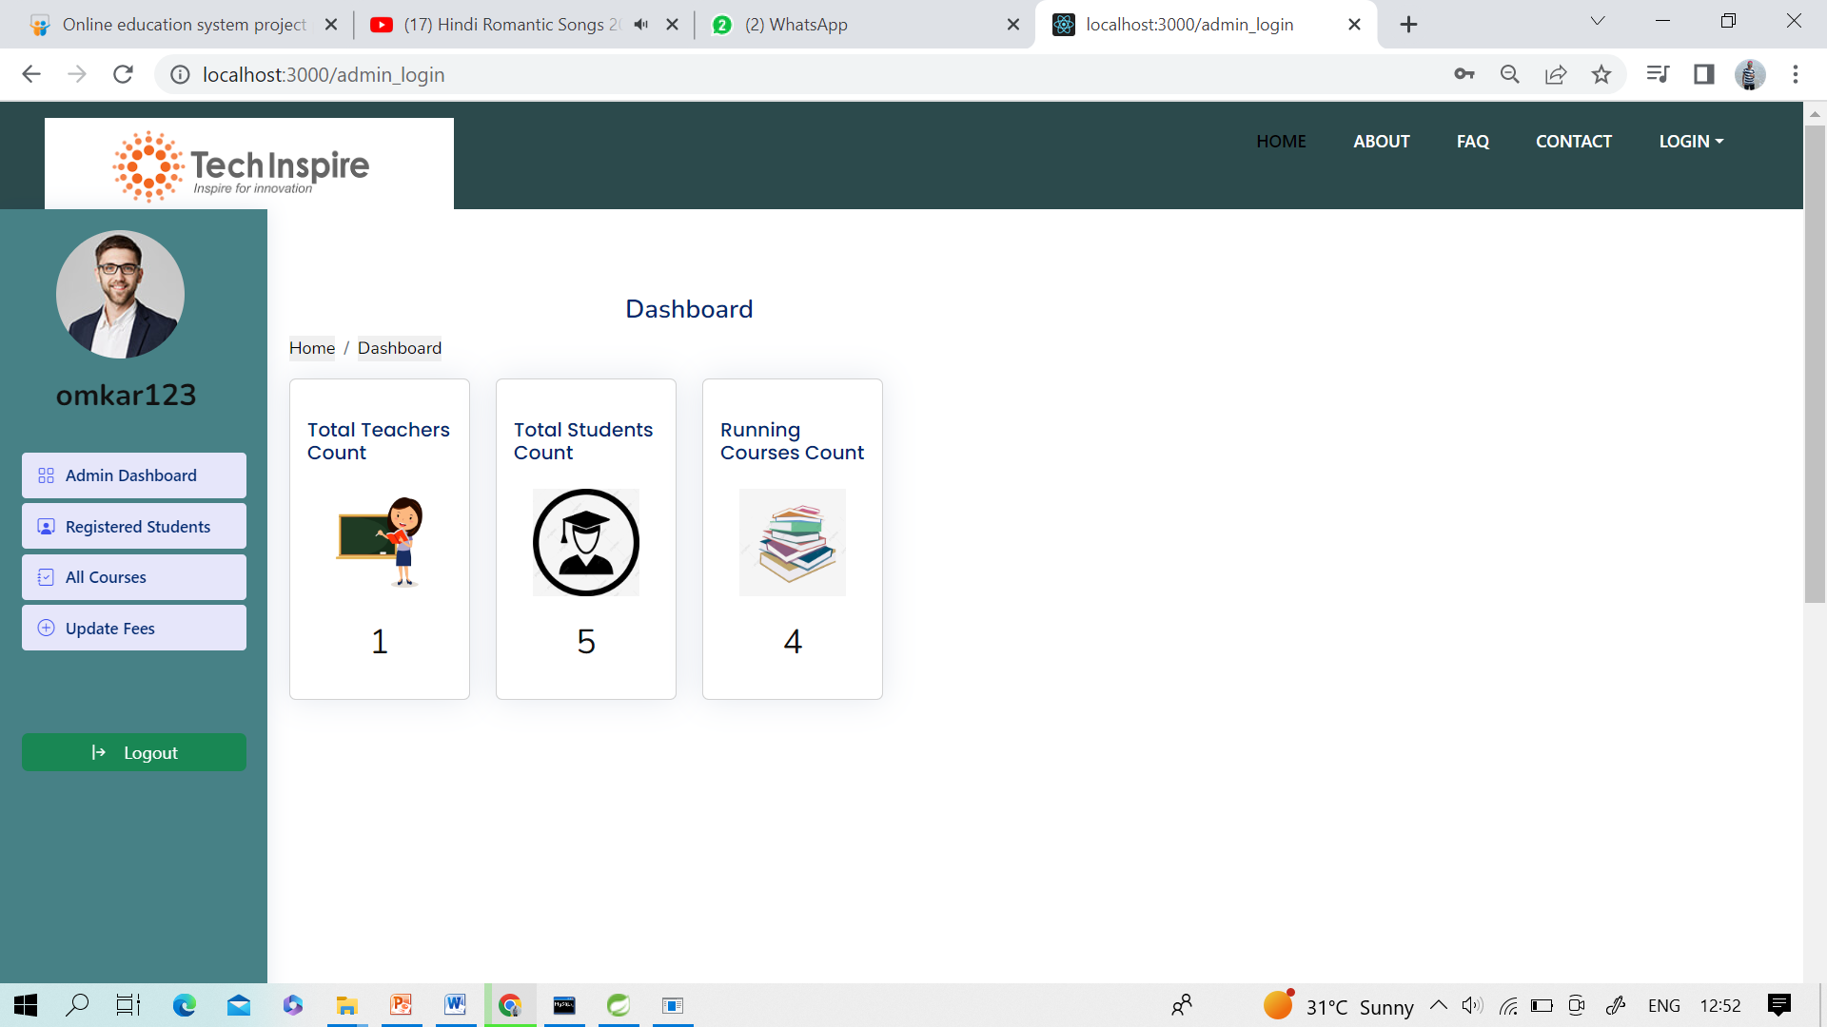
Admin Dashboard
Admin Module:
Admin module contains admin login/register page. After, login admin has dashboard containing options such like add/update Course. Admin Module has its own profile information with update option and logout option.

Slide 23
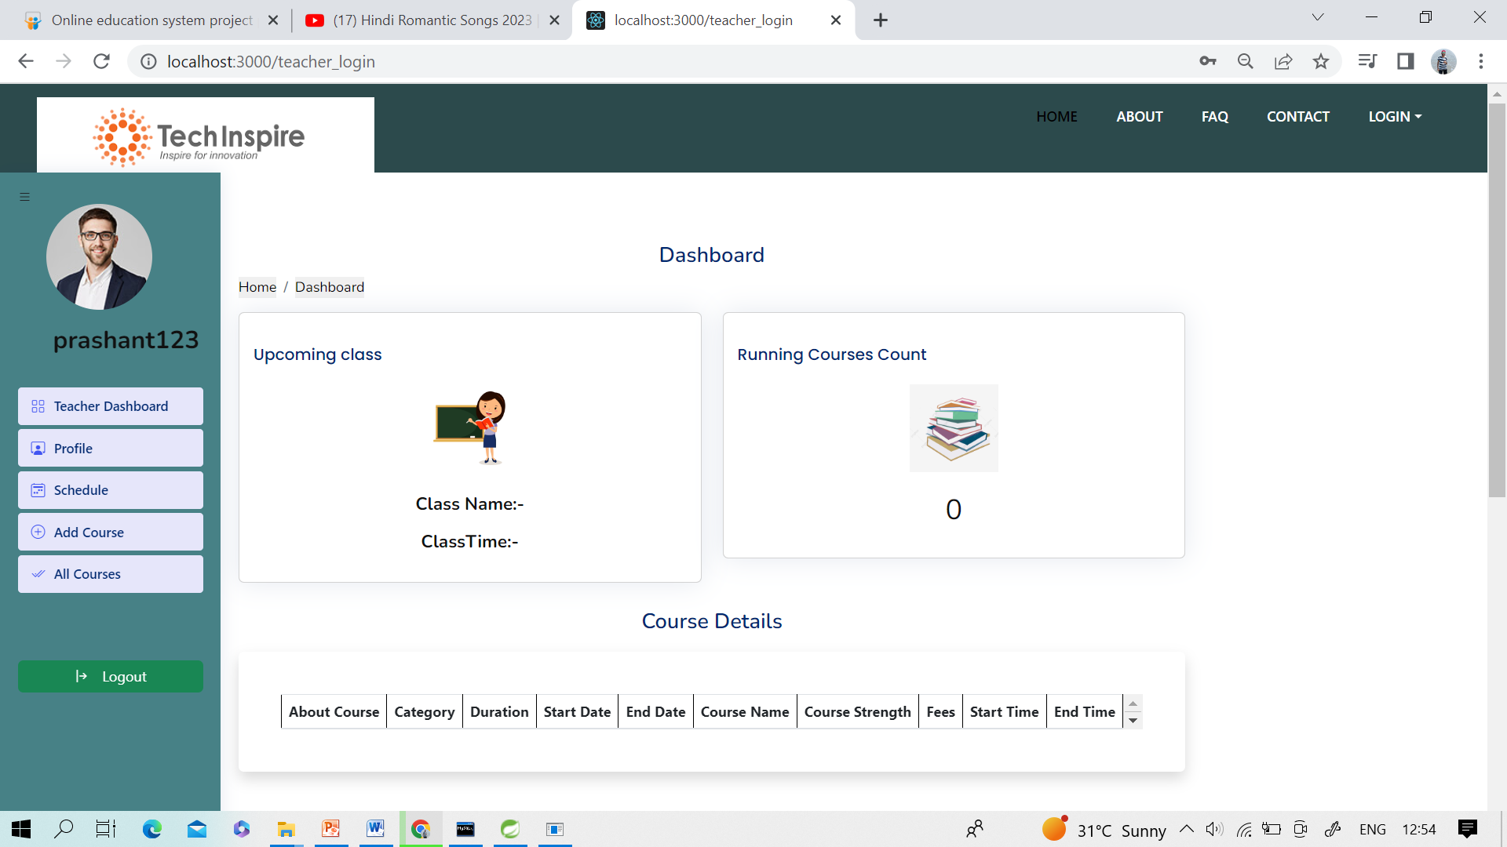
Teacher Dashboard
Teacher Module:
Teacher module contains login/register page. After, login Teacher has dashboard containing options such like add/update Courses, profile information of Student with update option and logout.

Slide 24
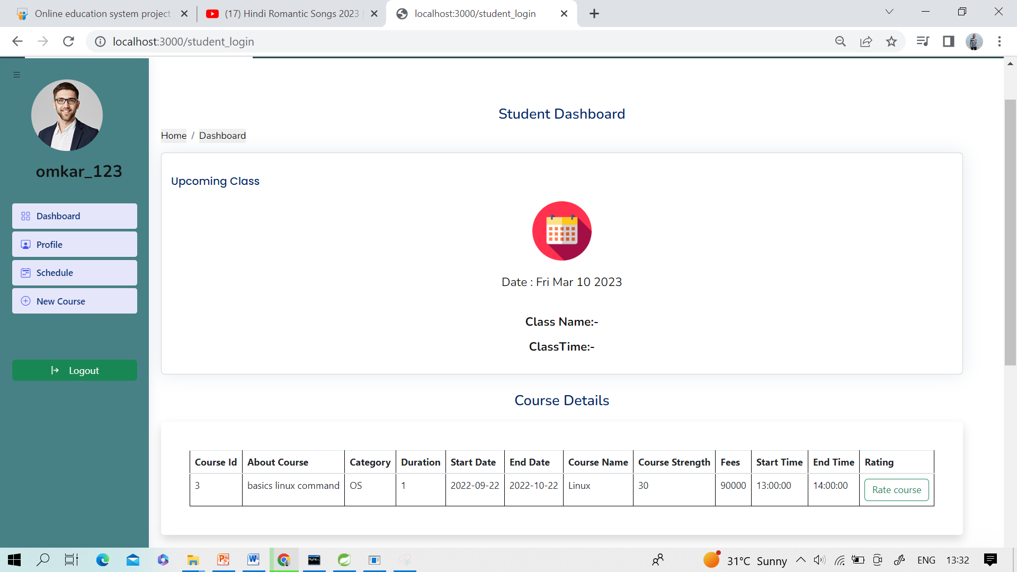
Student Dashboard
Student Module:
Student module contains student login/register page. After, login Student has dashboard containing options such like select the Course, profile information with update, view Course with choose the course option, feedback, logout.

Slide 25
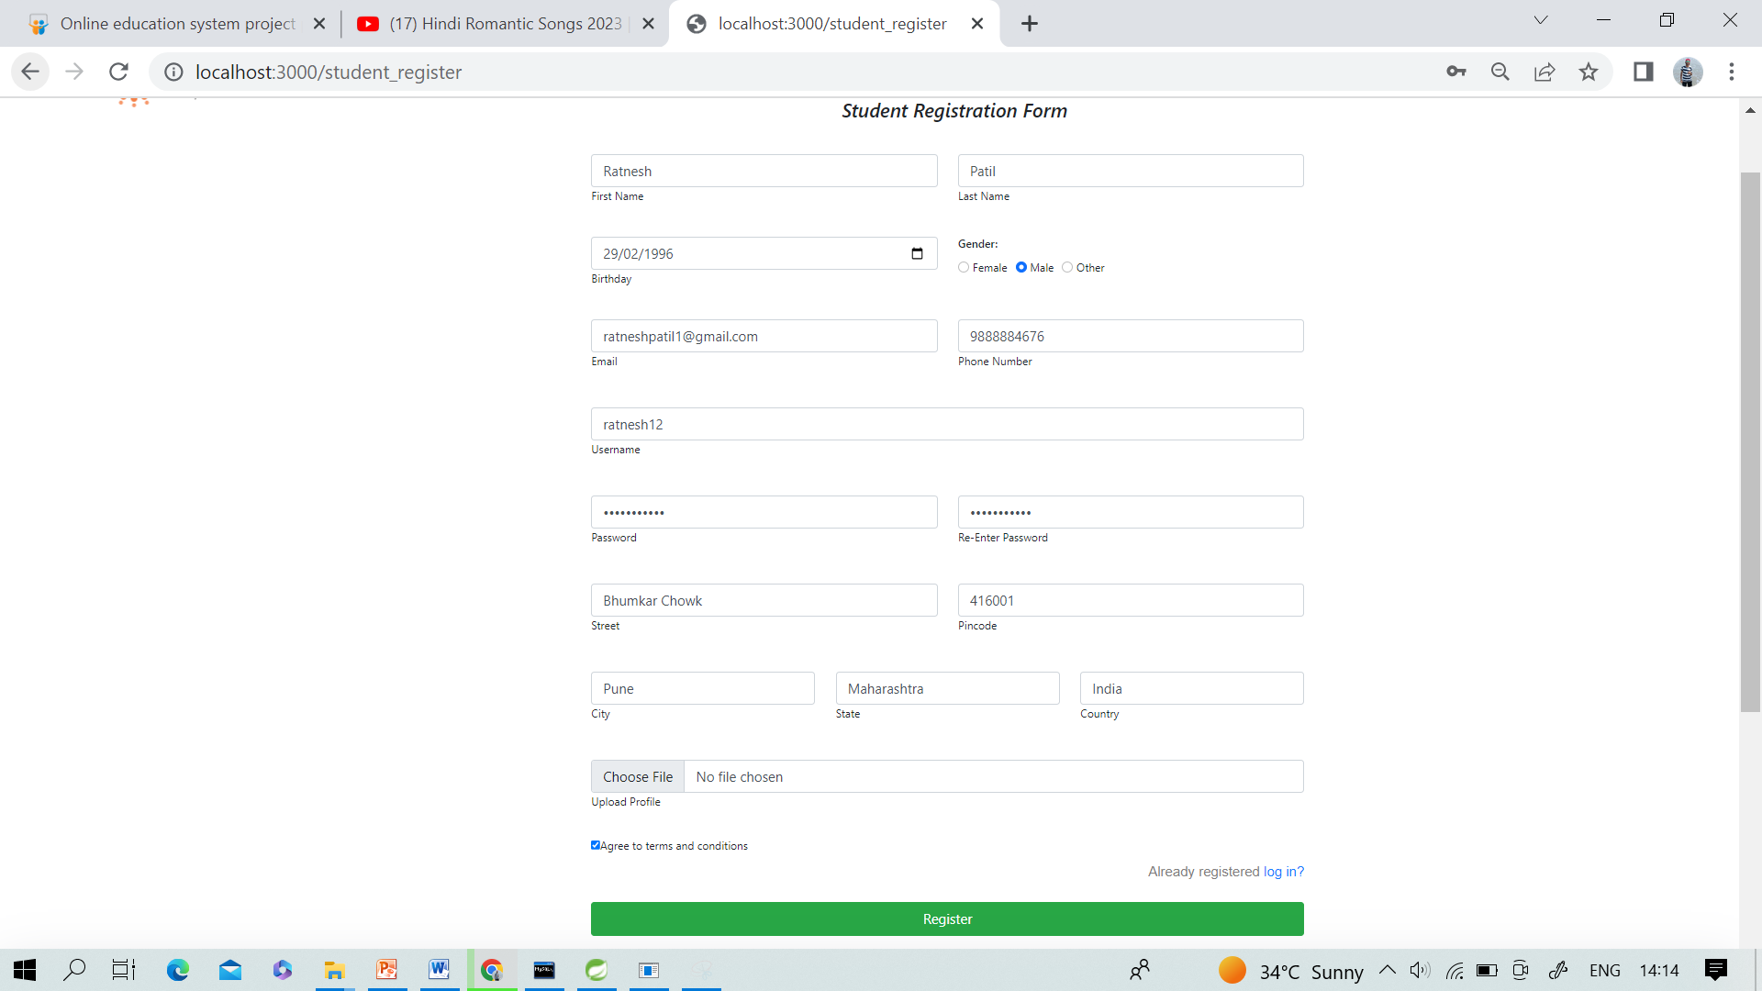
Student Registration

Slide 26
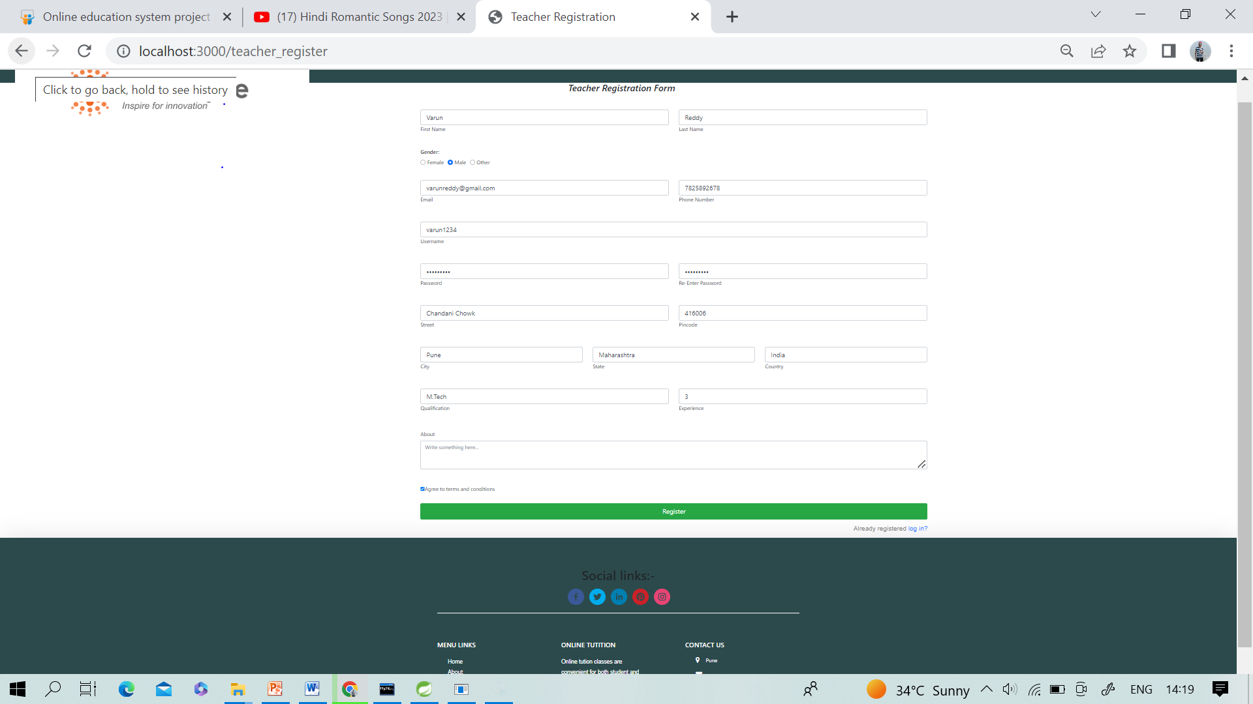


Teacher Registration:

Slide 27
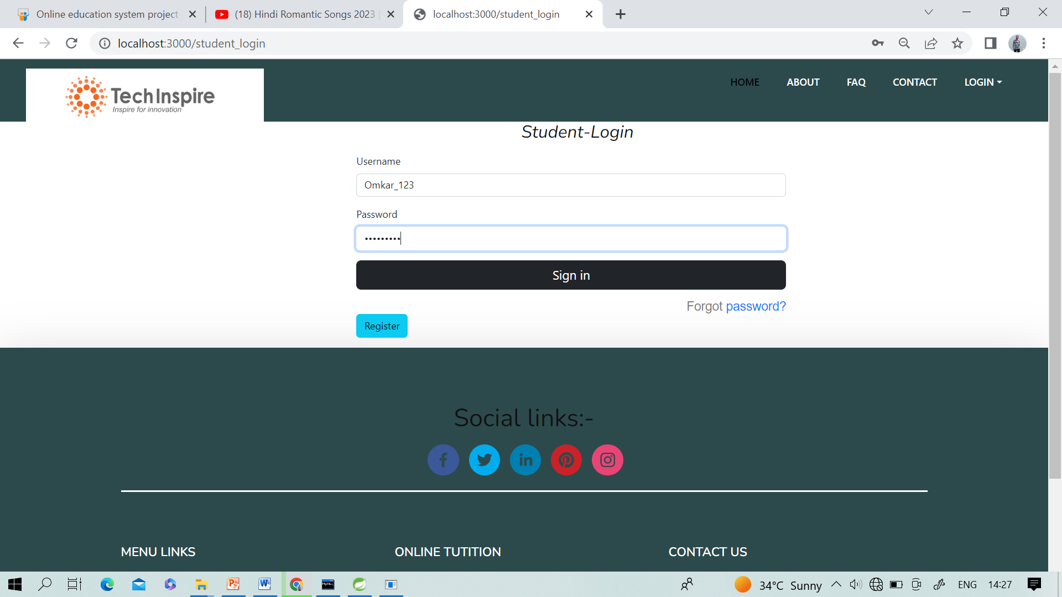
Student Login

Slide 28
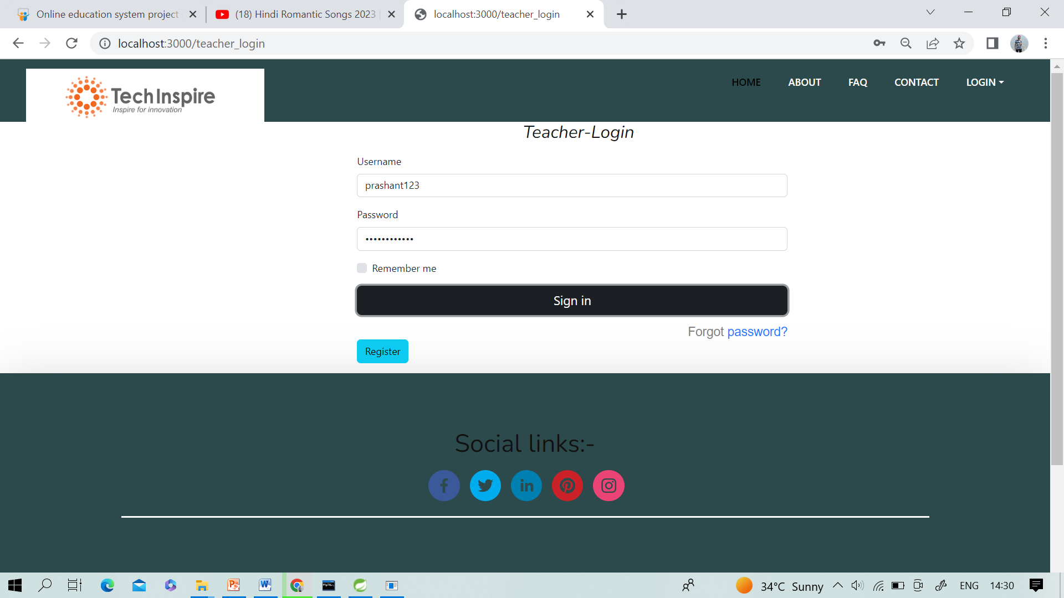
Teacher Login

Slide 29
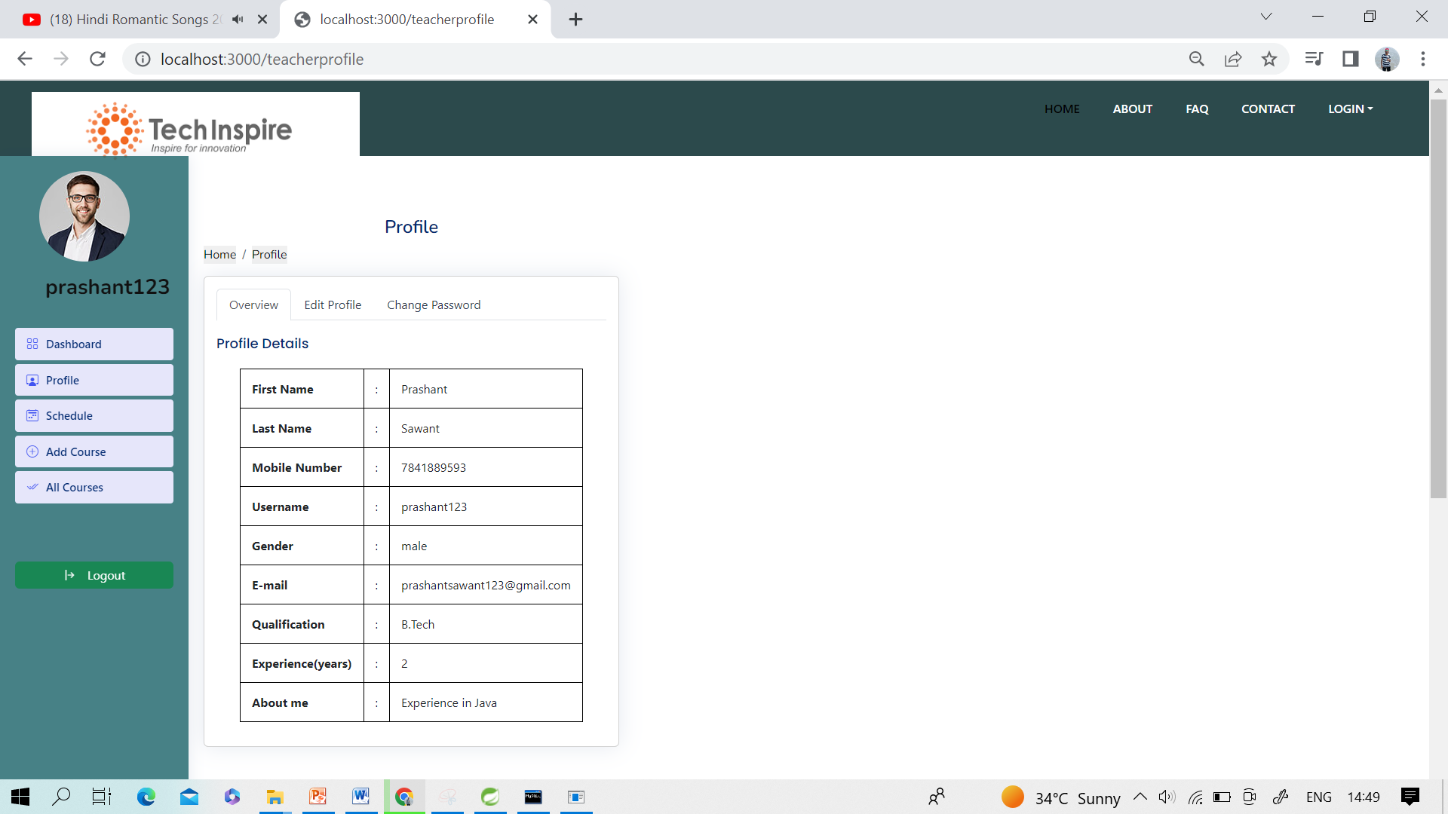
Teacher Profile

Slide 30
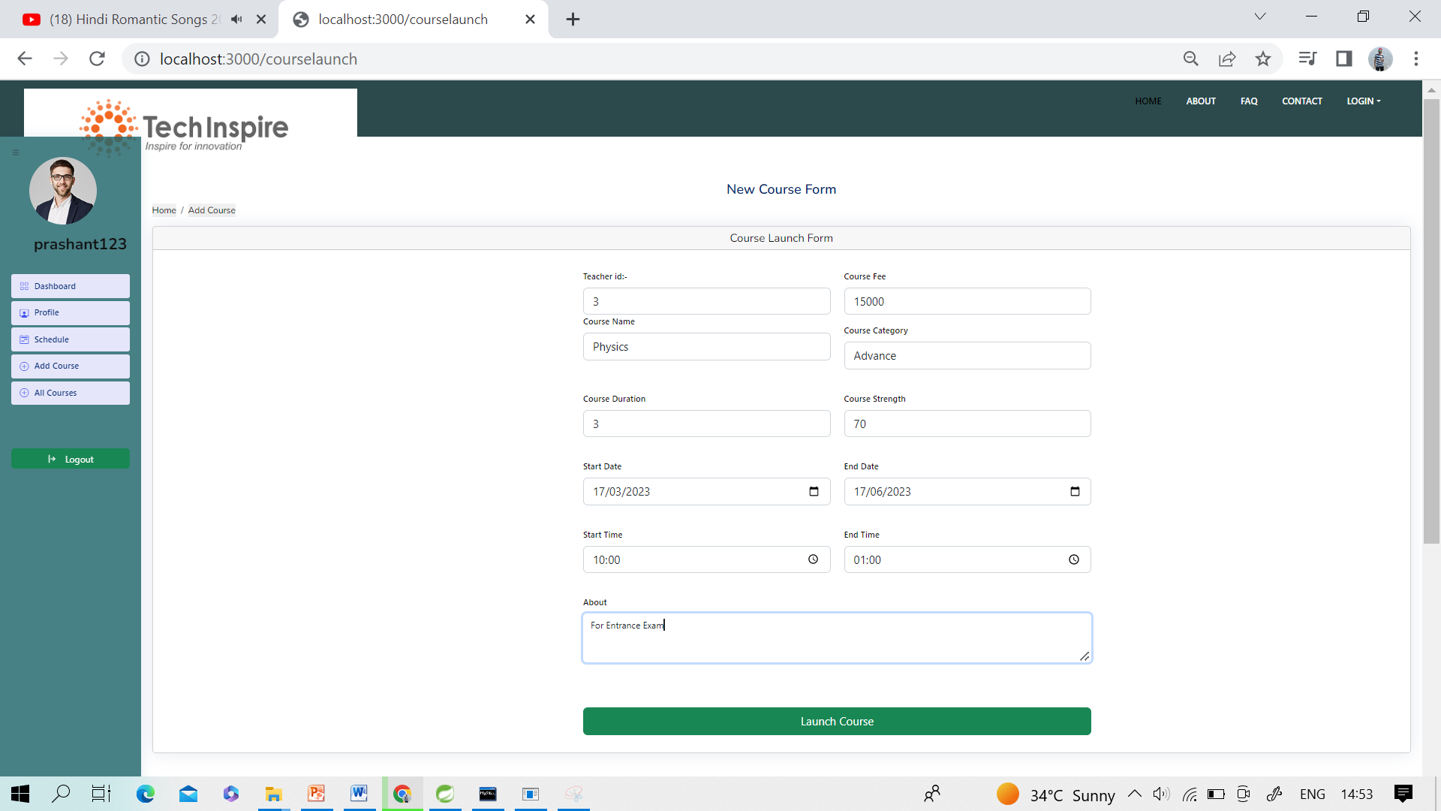
Course Launch Form

Slide 31
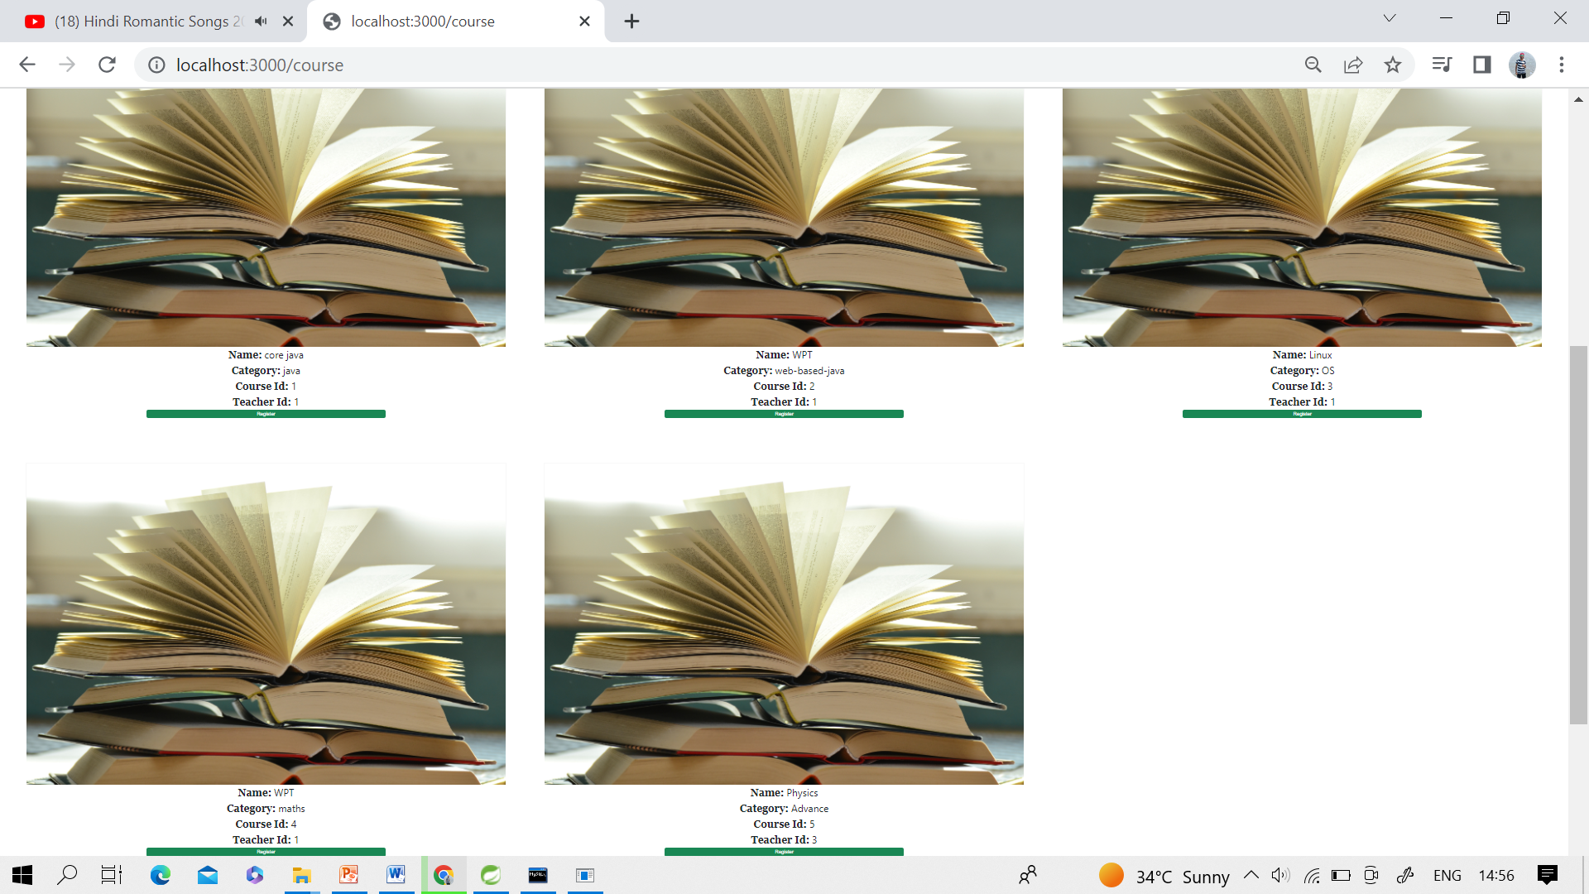

Courses

Slide 32
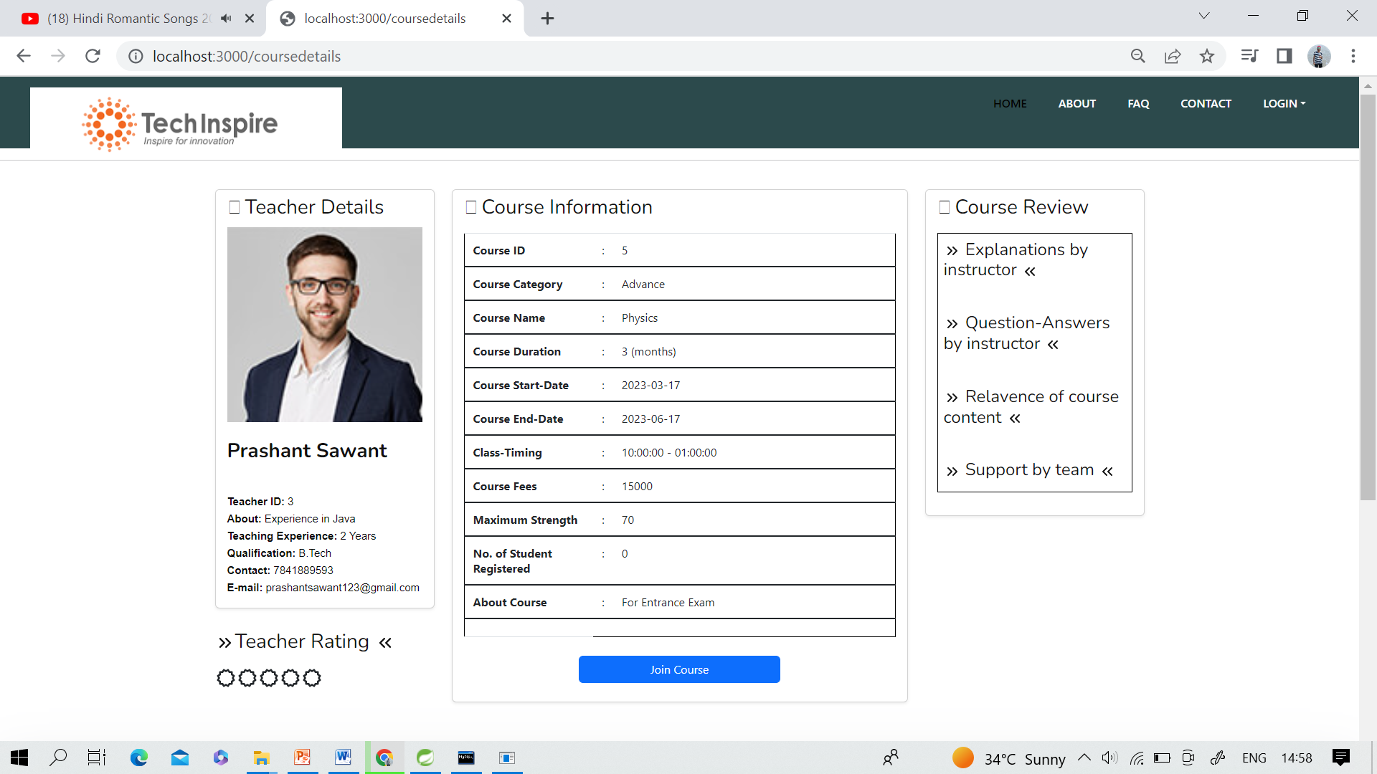
Teacher Details with Course

Slide 33
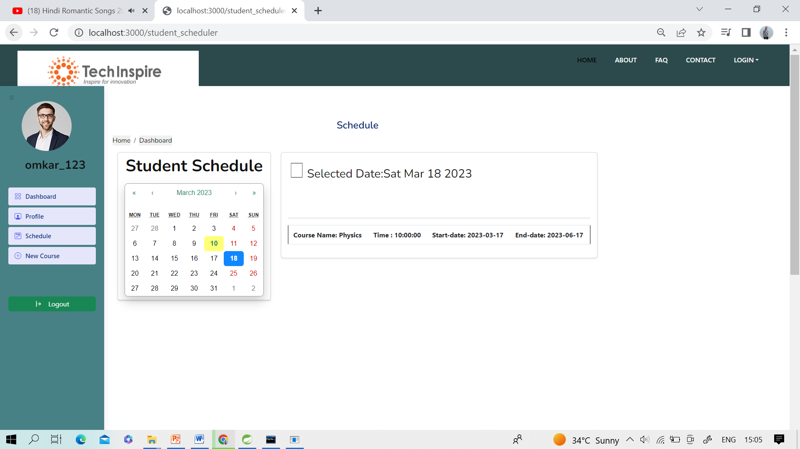
Student Schedule

Slide 34
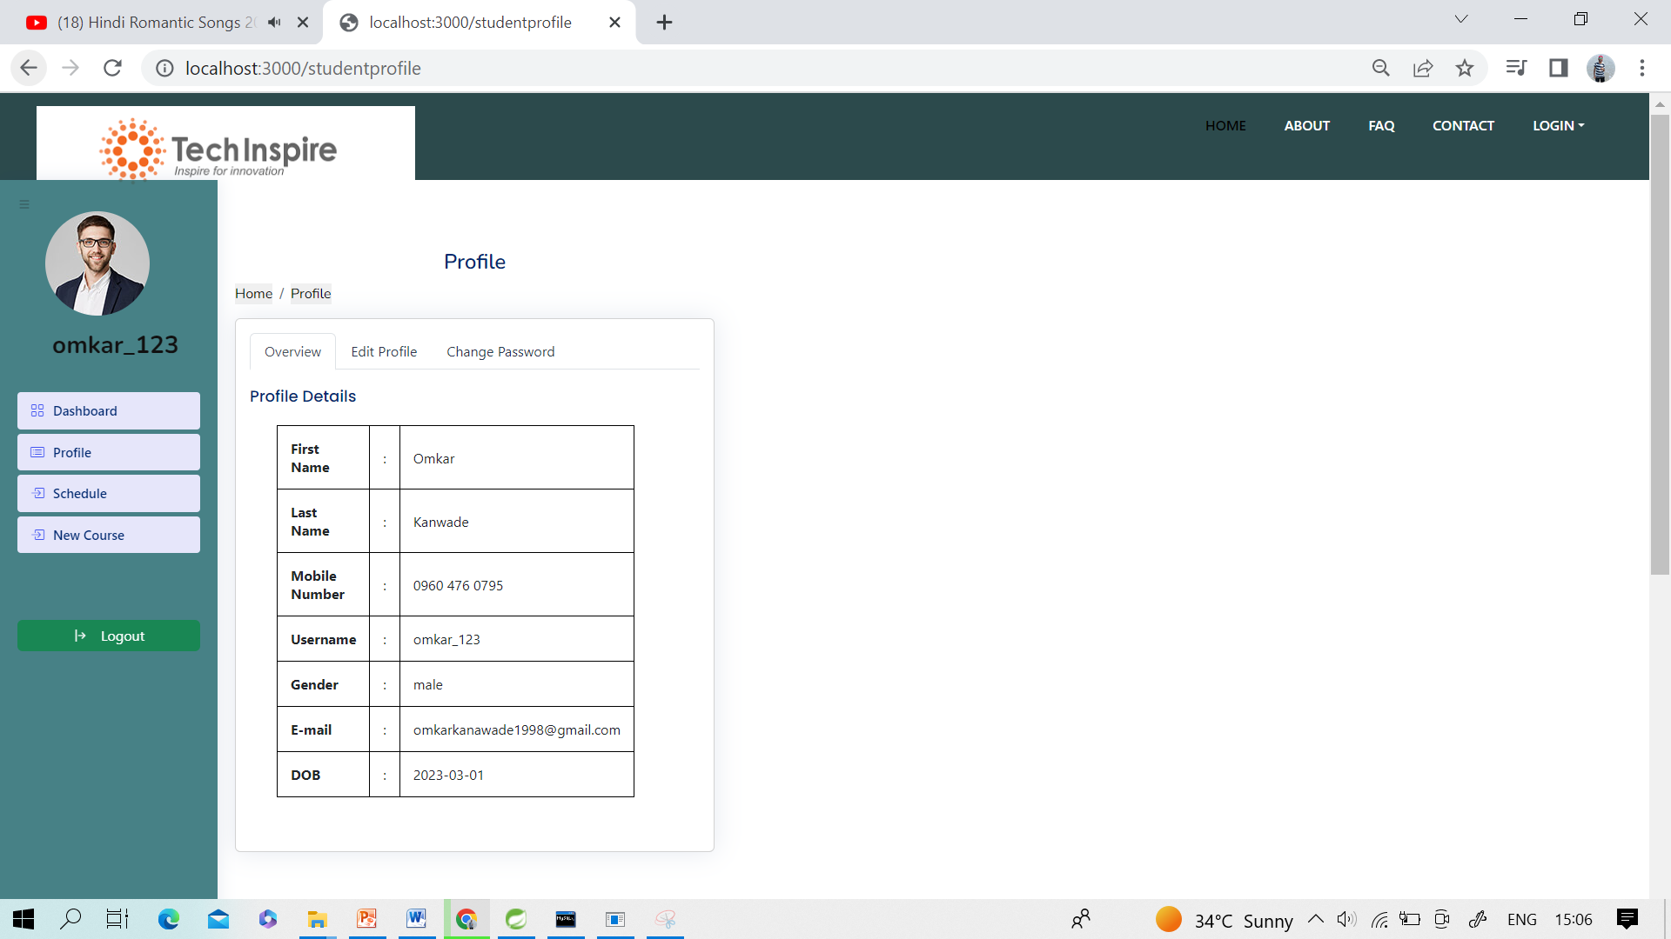
Student Profile

Slide 35
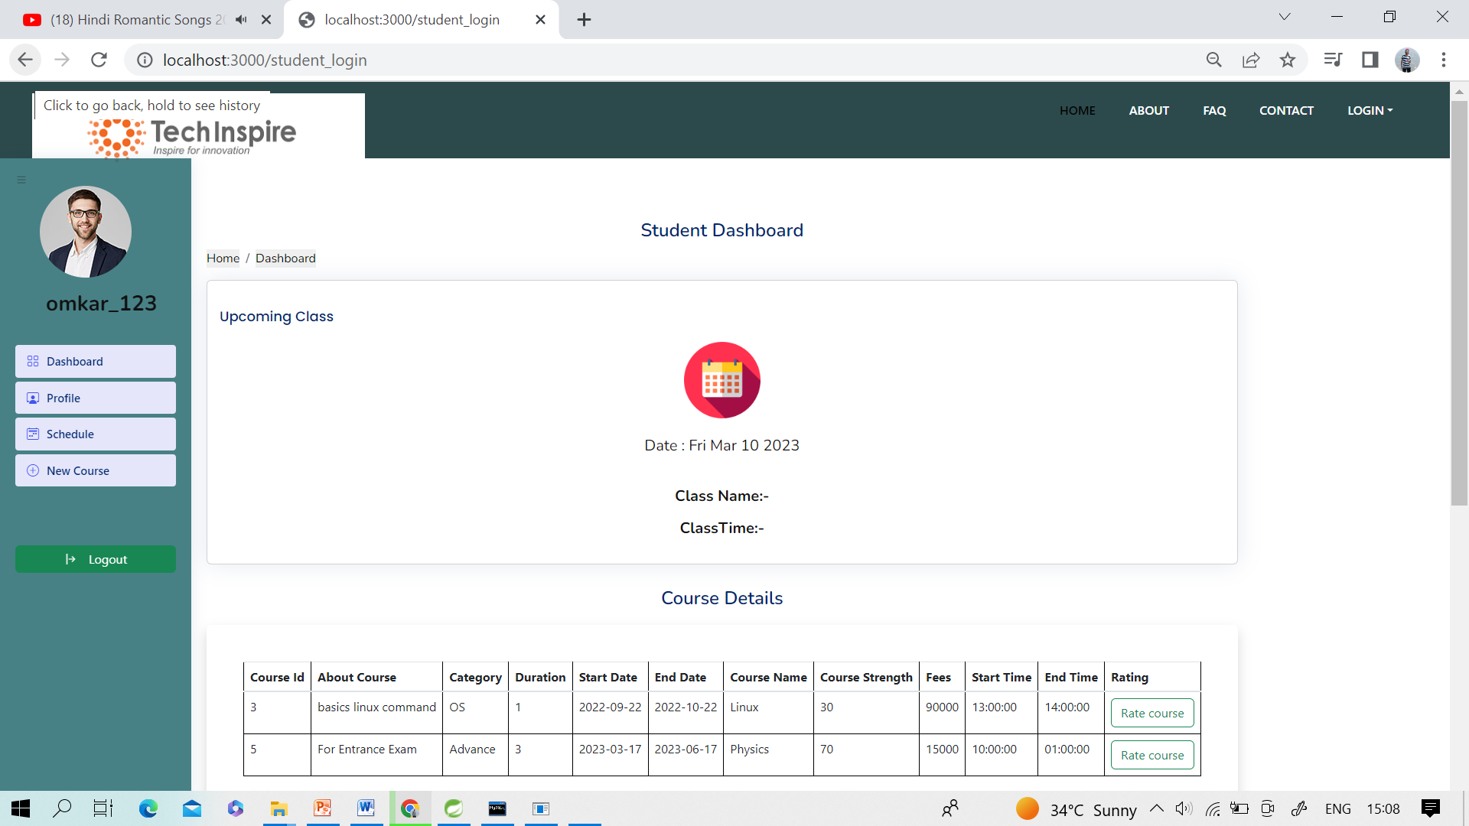

Slide 36
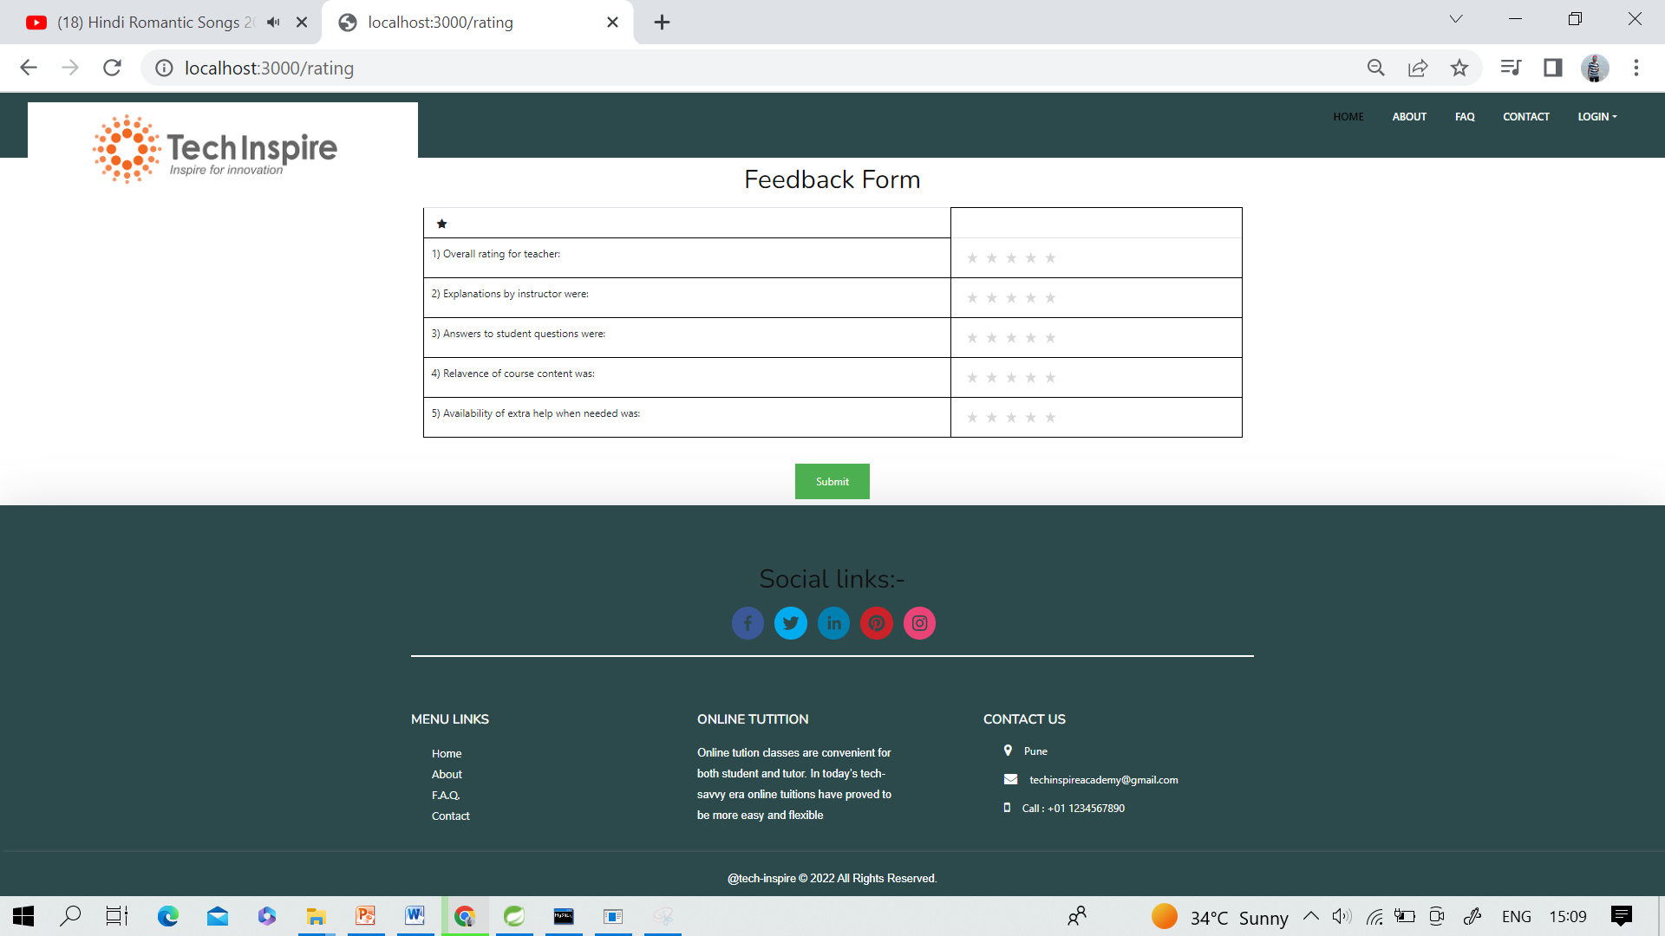
Feedback Form

Slide 37
Conclusion:
Online Education System has been developed and the system was tested with proper data. In comparison with the manual system, the benefit under a computer system considerable to save of manpower, working hour and efforts. It can observe that the information required can be obtained with ease and accurate in the computerized system.
The student with minimum knowledge about computer can be able operate the system easily. It saves time. It displays the information and result as the test gets over, so no need to wait for the result. It is automatically generated by the server.
The system has reached a steady state as far as the basic framework is concerned Various validation techniques have been used to implement accuracy of data in all formats of input.

Slide 38
Thank You

